Slide 1

Coach Different
A Primer on Coaching Agile Teams
Notes:
Good afternoon. I’d like to present to you a view of coaching agile teams that I’ve used the past 4 years. I’ll give it in the style of a pechakucha, that is about 20 slides each only taking about 20 seconds. The goal is to inform and persuade you to try it out for yourselves. Please hold your questions until the end, which should be roughly 10 minutes from now.

Slide 2
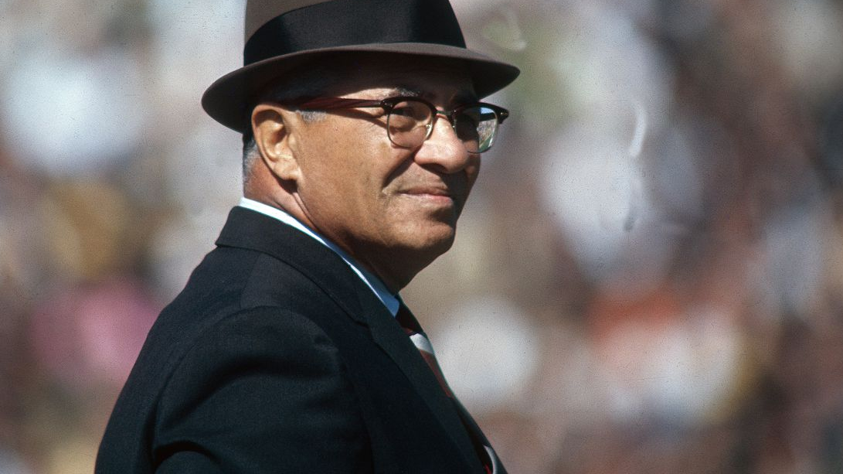
Notes:
What do you think of when you picture a coach? If you’re like me 5 years ago, you picture a person who:
Devizes strategy
Directs the action
Has authority over the players
Commands loyalty
And maybe even plays on the team as well
While there is certainly value in this sort of coaching, another style brings different benefits on Scrum and other sorts of agile team.

Slide 3

Notes:
A Scrum Master is called the servant leader of a team and one of their responsibilities is coaching. The servant leader as coach may require a different style of coaching, one that is likely to produce more servant leaders. This coach may take a different attitude with and position in their coaching which facilitates team members acting with focus, openness, courage, commitment, and respect.

Slide 4

Notes:
The first step of coaching in this new way is do form a stance. This is simply the collection of attitudes and positions that enable the coach and the coachee to interact in a particular way and achieve particular types of outcomes. It’s like a golf stance. Head down, feet apart, and shoulders square is more likely to produce a balanced swing and consistent contact with the ball.

Slide 5
Set expectations
Will you talk to others about this conversation?
Will you give advice?
Do you have tendencies your coachee should know about?
Will you remain neutral?
How will you listen?
What do you want in the relationship?
Notes:
When forming this stance, I’ve found these sorts of questions helpful to answer. [Read Questions]
Once formed, you use your stance to establish the environment of a coaching relationship.

Slide 6
My stance
What we discuss will remain confidential except for extreme details.
I will remain neutral and engaged; I will stand with you in the fire.
I will not give you advice.
I will call you forth to become what you most want to become.
I believe coaching is a relationship and will honor that by challenging you honestly and in love
I will follow my curiosity and see where it leads us.
Notes:
Take my stance for example. When I offer coaching to people, I generally present them with this. I ask the coachee to consider if this is the sort of relationship they want from a coach. If they agree, then we have found firm footing for having coaching conversations, even if the topics get intense.

Slide 7
The arc of a coaching conversation
E x p l o r e!
Are my biases showing?
Narrow down actions
What’s their agenda?
Create the environment
Commit to actions
Notes:
These conversations may be aided by a light, facilitative structure. This structure encourages the coachee to explore topics they most care about. The coach uses various attitudes and technique to coax and encourage the coachee. They identify barriers, find alternatives, and examine their own thinking. At the end, the coachee considers what actions they will take and is invited to share their results in the next conversation.

Slide 8

Explore
like a boss
With Powerful Questions
Notes:
One technique a coach may use is powerful questions. These are questions that encourage exploration, are open-ended, and stimulate lateral thinking. These questions usually start with “what” and not “how” or “why.” In fact, questions that start with “why” could produce a defensive reaction, such as “why did you do that?” Instead, the question, “what was important about that?” more reliably guides the coachee to examine their motives.

Slide 9
Starting Questions
What occurred since we last spoke?
What would you like to talk about?
Where are you right now?
Notes:
Here are some groups of powerful questions I might use to guide a coachee through a conversational arc. I’d start with questions like:
[read questions]
After just a few minutes, our conversation is oriented, and I’ve got enough information to let my curiosity take the conversation forward.

Slide 10
Exploration Questions
What is here you want to explore?
What other possibilities are there?
What are your options?
Notes:
Next, I use questions like these to invite exploration of the topics raised earlier. I might ask:
[read questions]
My goal here is to widen their view and lead them to discover new things they may have overlooked. This can help a coachee who is trapped by what logicians call a “False Choice.”

Slide 11
Assessment Questions
What was that like?
What about that resonates with you?
What must you believe for that to be true?
Notes:
After the coachee discovers more about their circumstance, they may need to assess what they’ve found. For this purpose, I’d use questions like:
[read questions]
These prompt the coachee to connect dead facts and circumstance with their own living framework of meaning. They decide how and why they feel about something or what they make of it.

Slide 12
Outcome Questions
What do you want?
If you got it, what might it look like?
What’s holding you back?
Notes:
Now the time is ripe to harvest learning and decision. I relish asking questions like:
[read questions]
These questions often land with powerful and sometimes terrible impact. The coachee is lead to confront their own inaction, examine the virtue of their desires, and state, maybe for the first time, their high dreams.

Slide 13
Taking Action Questions
Is this a time for action?
What are your next steps?
By what date will you complete these next steps?
Notes:
After doing this important work, it’s crucial to make something real of it. I’d use the following types of questions to encourage the coachee to action:
[read questions]
More often then not, little steps are all that’s needed for the coachee to get unstuck and moving towards accomplishing or becoming that thing they deeply desire.

Slide 14

Pro tips
Level 2 listening
Notes:
I’d like now to share a few tips that will aid your coaching conversations. Listening is an important skill for a coach to master. Most listening is distracted, unfocused, and done simply to formulate a response. Level 2 listening is a deep focus on what the coachee is saying. When distractions emerge, the coach gently brings her mind back to what is being said. The goal is to engage deeply and for the purpose of understanding and discovery.

Slide 15

Pro tips
Reflection
Notes:
Reflection is speaking back to the other what you believe they are saying. It sounds like, “What I hear you say is…” or “What I make up about that is…” These phrases are precisely crafted to offer a non-judgmental way of reflecting impact and comprehension. The coach confirms she is understanding and ensures that future questions track with the coachee’s thinking..

Slide 16

Pro tips
Reframing
Notes:
Reframing is a creative way to stimulate lateral thinking. Here are a couple examples. You might reframe a problem as a challenge. Problems are heavy and challenges can be enlivening. You might reframe statements like, “He was acting like a jerk” by wondering aloud, “What could cause you to act that way?” In this example, the coach reframes the “jerk” in a way that encourages empathy. The coachee might well consider that the “jerk” is not an enemy but someone having a rough day.

Slide 17

Pro tips
Keep a journal
Notes:
Keeping record of coaching conversations can be rewarding. A coach can prepare for a conversation by reading over her notes of the last. The coachee could be encouraged by how far they’ve come. Last, a coach may find new insight, simply by seeing the whole context of a conversation or of several conversations laid out in front of them on the page.

Slide 18

Learning curve
Listen for your biases
Notes:
Coaching takes work and you should expect you’ll struggle at first. If you’ve decided your stance should be a neutral one, you may find it difficult to avoid stating your opinion, offering advice, or biasing the coachee with narrowing questions too early in the conversation. Be patient with yourself and learn to listen for those things. You might find an experienced coach or a friend or loved one to practice with.

Slide 19

Learning curve
Grow your listening attention muscle
Notes:
That level 2 listening I mentioned earlier is quite difficult to master for me. When in that mode, avoid criticizing your lack of attention of focus. Rather, practice returning to what your coachee is saying. Ensure your environment is free from distraction. If you practice long enough, you will find your attention and your focus grows to stay with your coachee for the whole conversation.

Slide 20

Learning curve
Persevere and check for impact
Notes:
You may wonder if you’re helping at all. This self-doubt might be valid and it might not. Check with your coachee for the impact of your conversations. Examine your journal for signs of progress. Persevere through the doubt. You might need to find your own coach or form a community of coaching practice. Though your doubt may prevail against you alone, you and another may stand against it, and a group of 3 is not easily overcome.

Slide 21
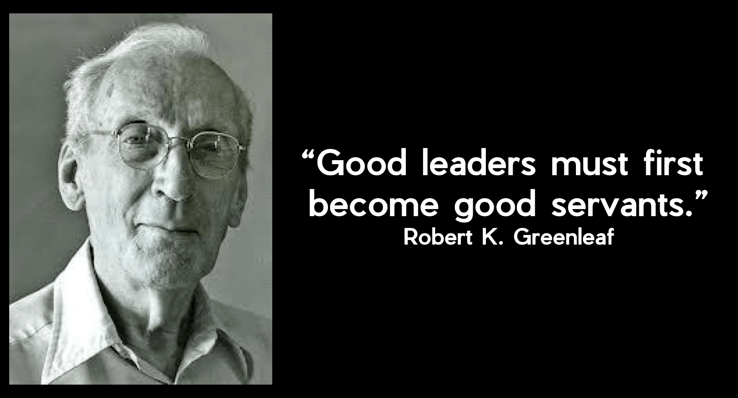
Notes:
Robert Greenleaf wrote, [reak quote.] If you are a Scrum Master, this is how you are expected to lead. Greenleaf also wrote on the difference between title leaders and servant leaders,
“The difference manifests itself in the care taken by the servant-first to make sure that other people’s highest priority needs are being served. The best test, and difficult to administer, is: Do those served grow as persons? Do they, while being served, become healthier, wiser, freer, more autonomous, more likely themselves to become servants? And, what is the effect on the least privileged in society? Will they benefit or at least not be further deprived?“
I find that coaching in the way I’ve described aligns strongly with the principles of servant leadership and can have surprisingly positive effect for you and your Scrum teams.

Slide 22
Additional Learning
Powerful Questions
https://learn.coactive.com/hubfs/2019%20Toolkit/Co-Active-Coaching-Toolkit-POWERFUL%20QUESTIONS.pdf
Coaching Agile Teams Book:
https://www.lyssaadkins.com/coaching-agile-teams-book
The Servant as Leader:
http://www.ediguys.net/Robert_K_Greenleaf_The_Servant_as_Leader.pdf
Coaching Agile Teams Training:
https://develop.agilecoachinginstitute.com/coaching-agile-teams/
Reach out, I’d love to help ☺
jason.t.knight@gmail.com
Notes:
I’d like to leave you with several aids to your learning. You can use the powerful questions paper, Lyssa Adkins “Coaching Agile Teams” book and the “Coaching Agile Teams” training course to spur yourself to develop into a competent coach. If you are interested in exploring servant leadership further, I’ve also included Greenleafs essay on the subject. Last, I’m happy to chat more about this if you want that conversation.

Slide 23

Let’s talk!
Notes:
Now, I invite you to share the impact of what you’ve heard. What is here that you’d like to talk about?

